Slide 1
Implementing ELLA
Linking ELLA to the National Quality Standards

Slide 2
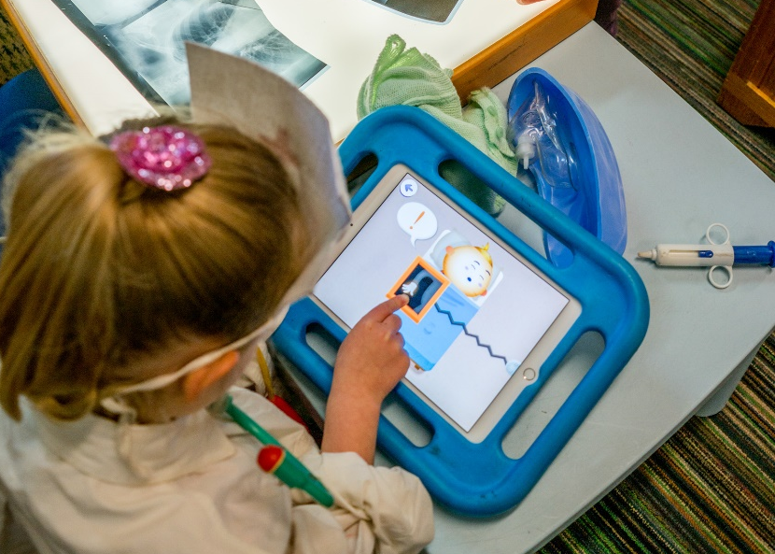
Educational program and practice
1.1 Program
The educational program enhances each child’s learning and development.
1.1.1 Approved learning framework
The apps have been designed to be play-based, in line with the Early Years Learning Framework (EYLF) learning outcomes.
Each of the seven apps includes learning spaces that align with different learning outcomes and offer different play types.

Slide 3
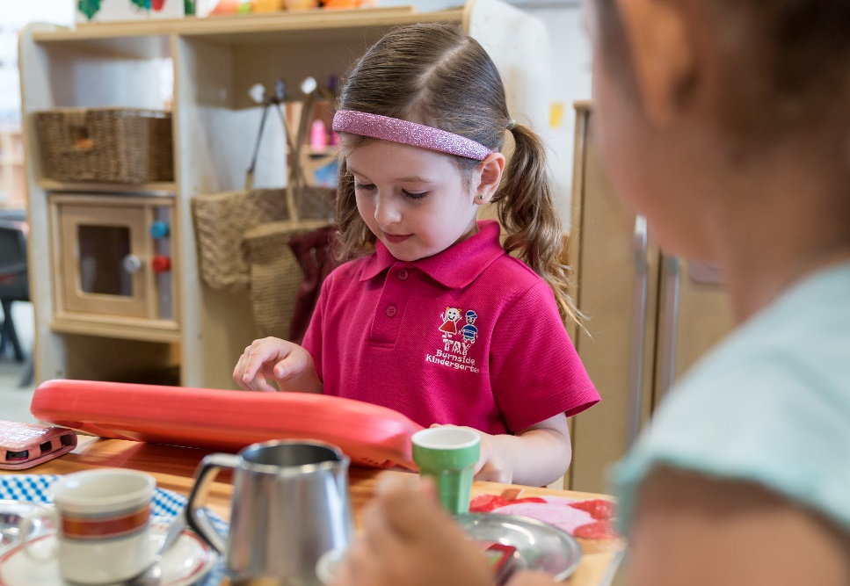
Educational program and practice
1.1 Program
The educational program enhances each child’s learning and development.
1.1.2 Child-centred
The apps depict environments familiar to Australian preschoolers.
Language is introduced to build on the children’s interests and current knowledge.

Slide 4
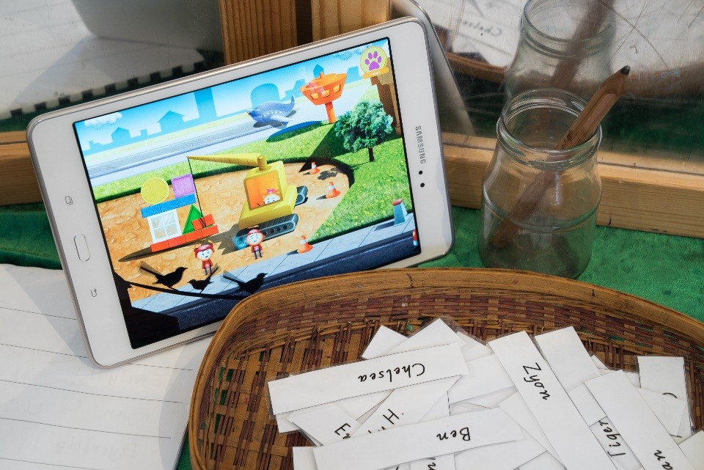
Educational program and practice
1.1 Program
The educational program enhances each child’s learning and development.
1.1.3 Program learning opportunities
Educators develop routines around technology use and the sharing of devices.
Transitions can be a great opportunity to use the chosen language.
There are also opportunities for speaking, singing and reading in a variety of group settings.

Slide 5
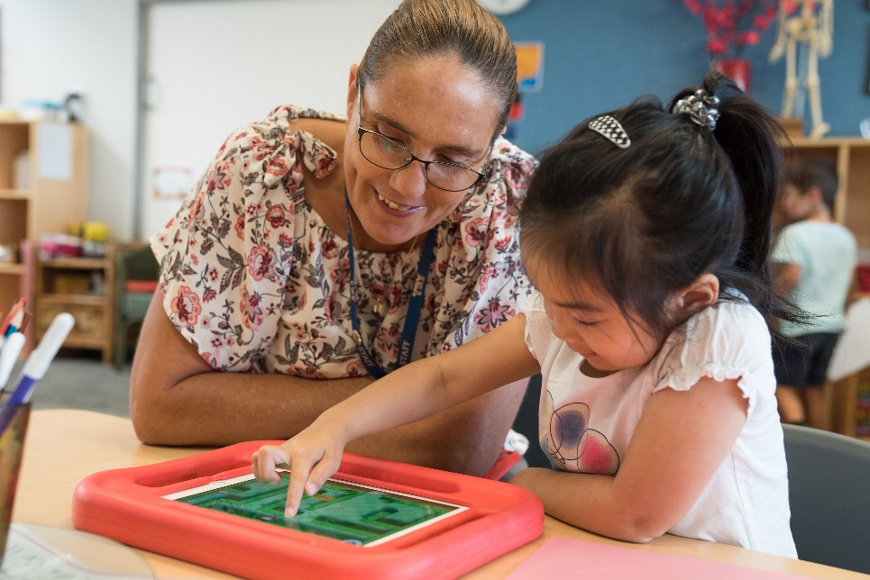
Educational program and practice
1.2 Practice
Educators facilitate and extend each child’s learning and development.
1.2.1 Intentional teaching
Educators become co-learners with the children.
They demonstrate good learning practices including asking questions, practising new skills, seeking help, and sharing ideas and knowledge.

Slide 6
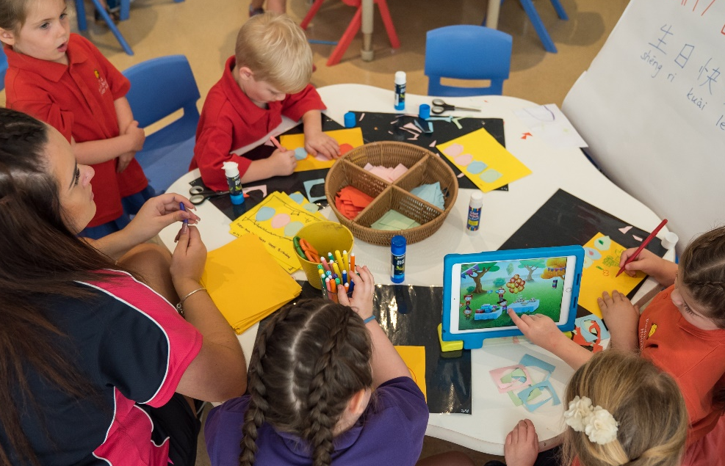
Educational program and practice
1.2 Practice
Educators facilitate and extend each child’s learning and development.
1.2.2 Responsive teaching and scaffolding
Early childhood educators have the skills and knowledge to respond to the children’s needs and interests.
They scaffold concepts from the apps into other aspects of the preschool program.

Slide 7
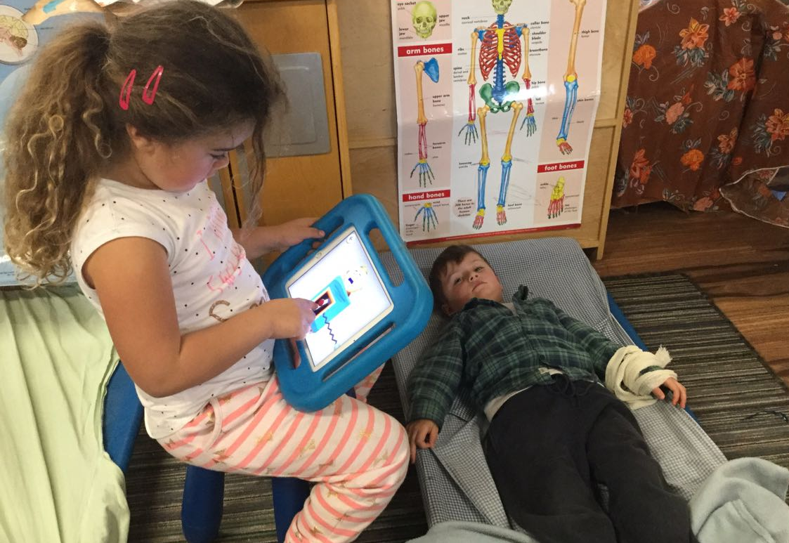
Educational program and practice
1.2 Practice
Educators facilitate and extend each child’s learning and development.
1.2.3 Child directed learning
Responsive learning relationships are strengthened as children contribute to decisions about the way tablet devices are used in the program.

Slide 8
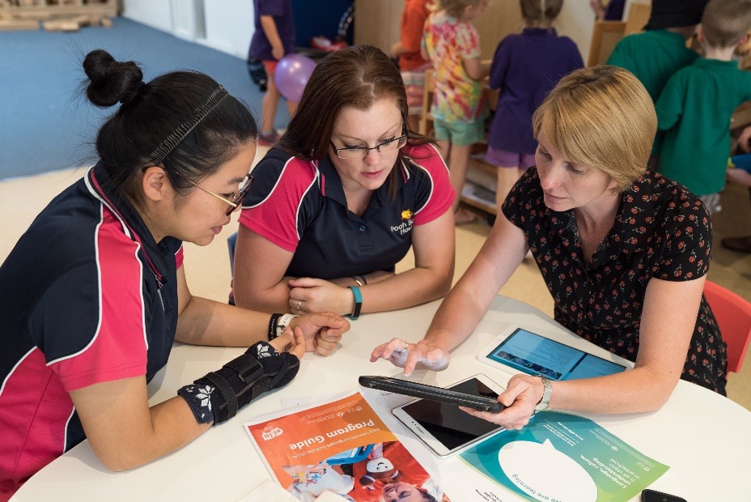
Educational program and practice
1.3 Assessment and planning cycle
Educators and co-ordinators take a planned and reflective approach to implementing the program for each child.
1.3.1 Assessment and planning cycle
Normal observation practices can be used alongside the data collected by the ELLA apps and information presented in the ‘I can’ statements.

Slide 9
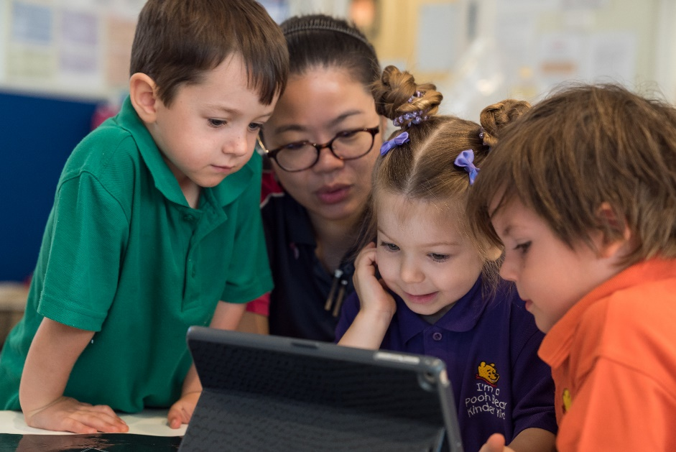
Educational program and practice
1.3 Assessment and planning cycle
Educators and co-ordinators take a planned and reflective approach to implementing the program for each child.
1.3.2 Critical reflection
Educators think critically about the effectiveness of using technology to improve children’s language development.

Slide 10
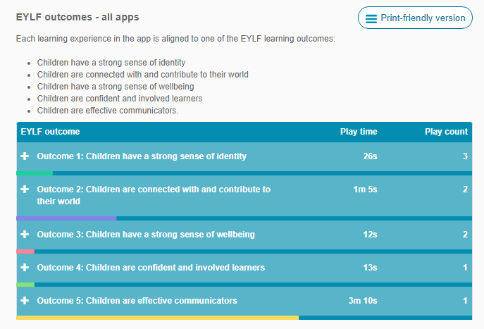
Educational program and practice
1.3 Assessment and planning
Educators and co-ordinators take a planned and reflective approach to implementing the program for each child.
1.3.3 Information for families
Data is recorded and can be shared with families.
Educators can share the outcomes a child has been working on and the amount of time spent in the different learning spaces of the apps.

Slide 11
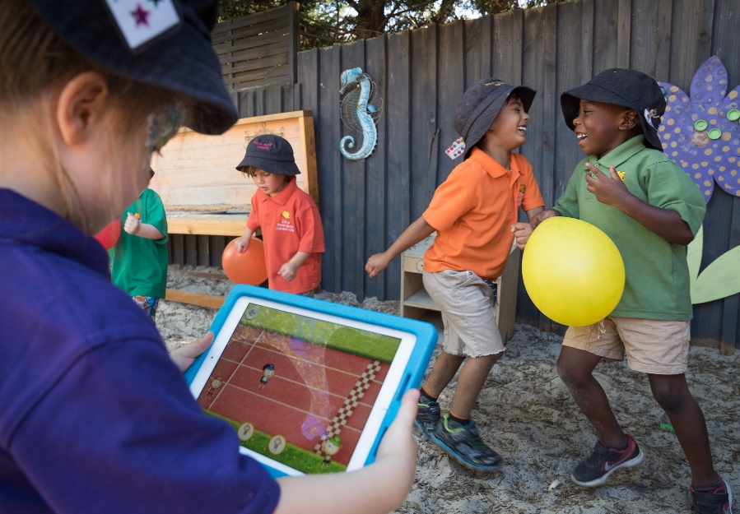
Physical environment
3.2 Use
The service environment is inclusive, promotes competence and supports exploration and play-based learning.
3.2.1 Inclusive environment
ELLA can be adapted to suit the needs of individual children, within indoor and outdoor environments.

Slide 12
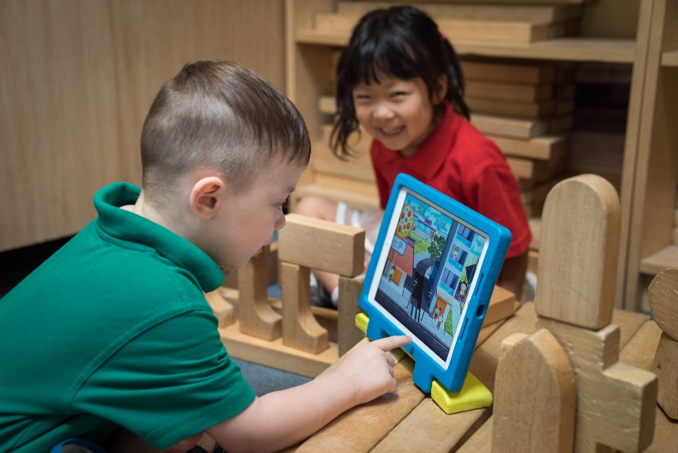
Physical environment
3.2 Use
The service environment is inclusive, promotes competence and supports exploration and play-based learning.
3.2.2 Resources support play-based learning
Devices can be used within a range of play environments.
The apps have been designed to be play-based, in line with the EYLF principles and practice, and include different play types.

Slide 13
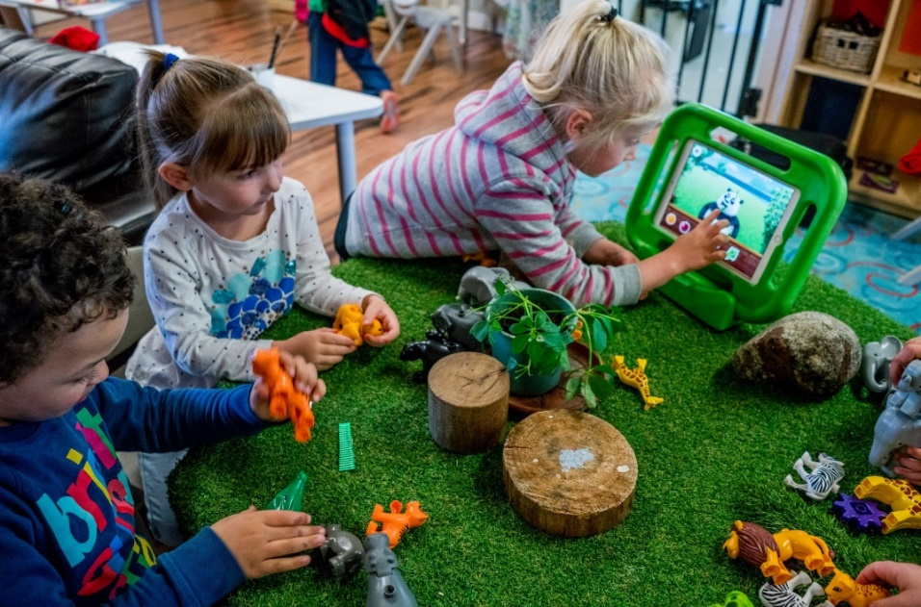
Physical environment
3.2 Use
The service environment is inclusive, promotes competence and supports exploration and play-based learning.
3.2.3 Environmentally responsible
ELLA promotes interest in the natural world.

Slide 14
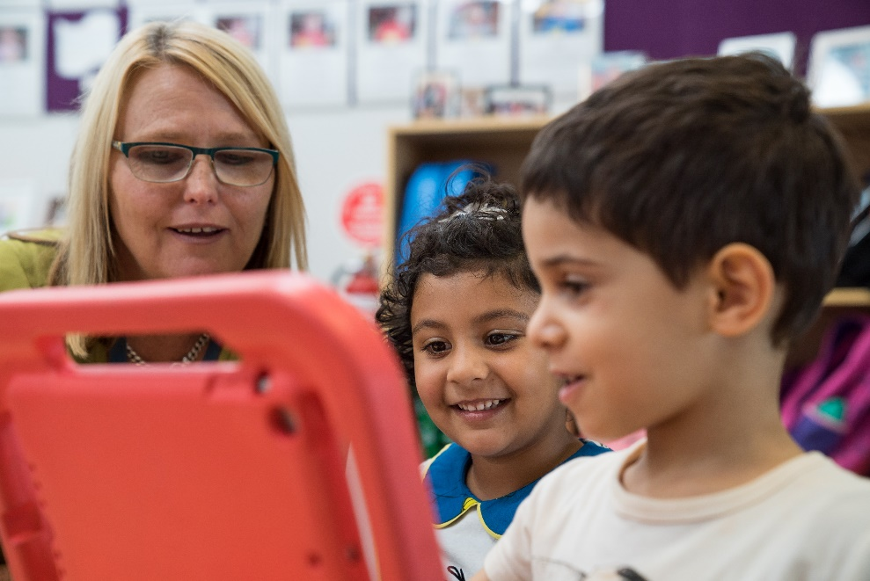
Relationships with children
5.1 Relationships between educators and children
Respectful and equitable relationships are maintained with each child.
5.1.1 Positive educator to child interactions
The program has a strong focus on language learning for both children and educators. This encourages responsive interactions.
The co-learning approach helps build trusting relationships.

Slide 15
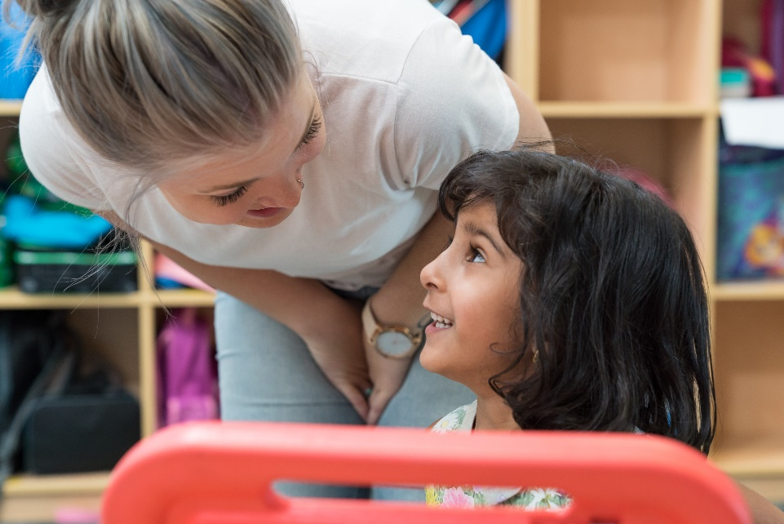
Relationships with children
5.1 Relationships between educators and children
Respectful and equitable relationships are maintained with each child.
5.1.2 The dignity and rights of every child are maintained
ELLA supports children by validating cultural and linguistic difference.

Slide 16
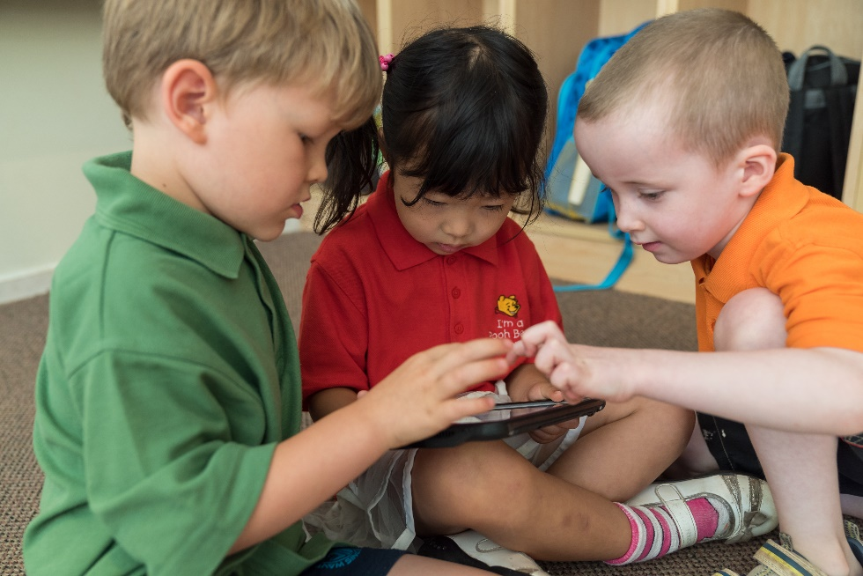
Relationships with children
5.2 Relationships between children
Each child is supported to build and maintain sensitive and responsive relationships.
5.2.1 Collaborative learning
The ELLA program promotes learning as a social activity and values collaborative learning and community participation.

Slide 17
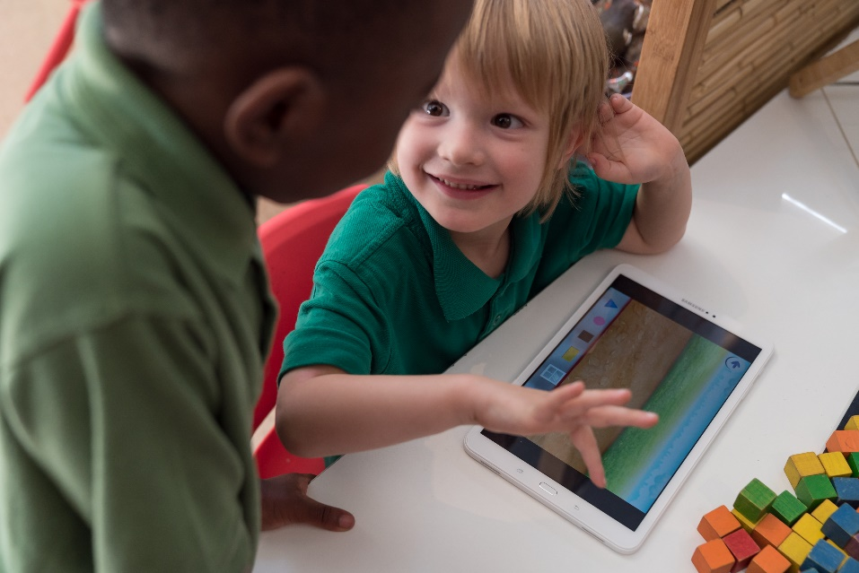
Relationships with children
5.2 Relationships between children
Each child is supported to build and maintain sensitive and responsive relationships.
5.2.2 Self-regulation
Children care for the equipment and are sensitive to the rights of others to use the devices.
Incorporating tablets into the preschool program also prepares children for the appropriate use of technology in school.

Slide 18
Collaborative partnerships with families and communities
6.1 Supportive relationships with families
Respectful relationships with families are developed and maintained and families are supported in their parenting role.
6.1.1 Engagement with the service
Educators invite families or members of the community into the preschool.
ELLA provides opportunities for educators to embed cultural diversity within their program.

Slide 19
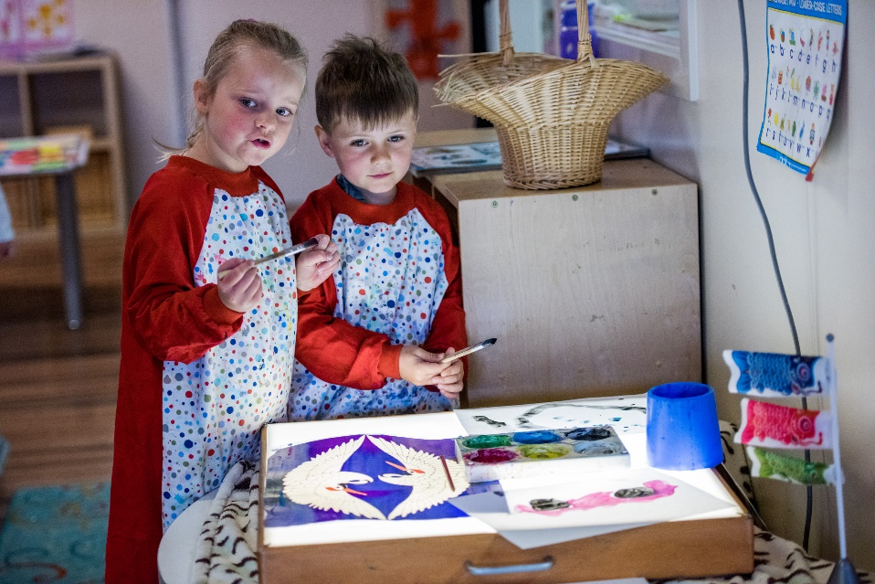
Collaborative partnerships with families and communities
6.1 Supportive relationships with families
Respectful relationships with families are developed and maintained and families are supported in their parenting role.
6.1.2 Parent views are respected
Families are encouraged to share their home language, culture and travel experiences.
Families reflect on appropriate technology use for preschoolers.

Slide 20
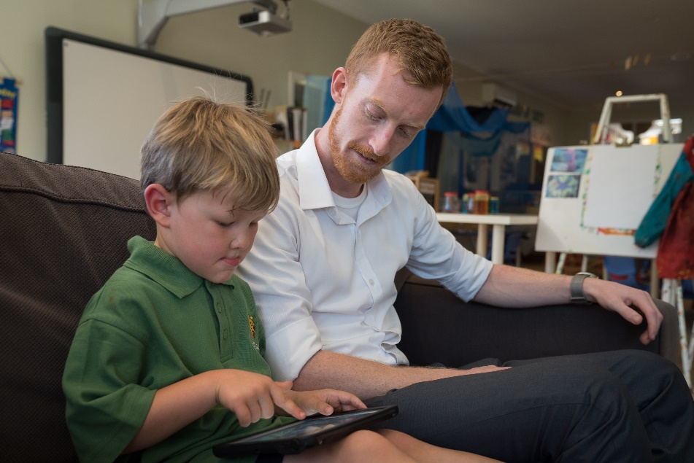
Collaborative partnerships with families and communities
6.1 Supportive relationships with families
Respectful relationships with families are developed and maintained and families are supported in their parenting role.
6.1.3 Families are supported
The ELLA program helps to build partnerships with families by providing newsletters and other resources for families.
Families have opportunities to contribute to the preschool program.

Slide 21
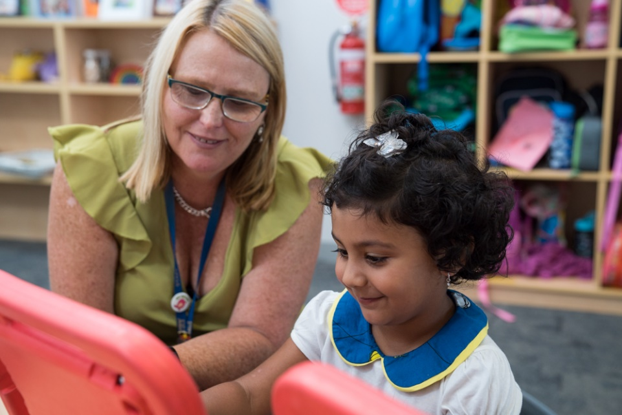
Collaborative partnerships with families and communities
6.2 Collaborative partnerships
Collaborative partnerships enhance children’s inclusion, learning and wellbeing.
6.2.1 Transitions
It is recommended that families and languages offered at local primary schools are considered when choosing a target language.
The amount of time spent on the ELLA apps and EYLF outcomes is recorded as data that can be shared.

Slide 22
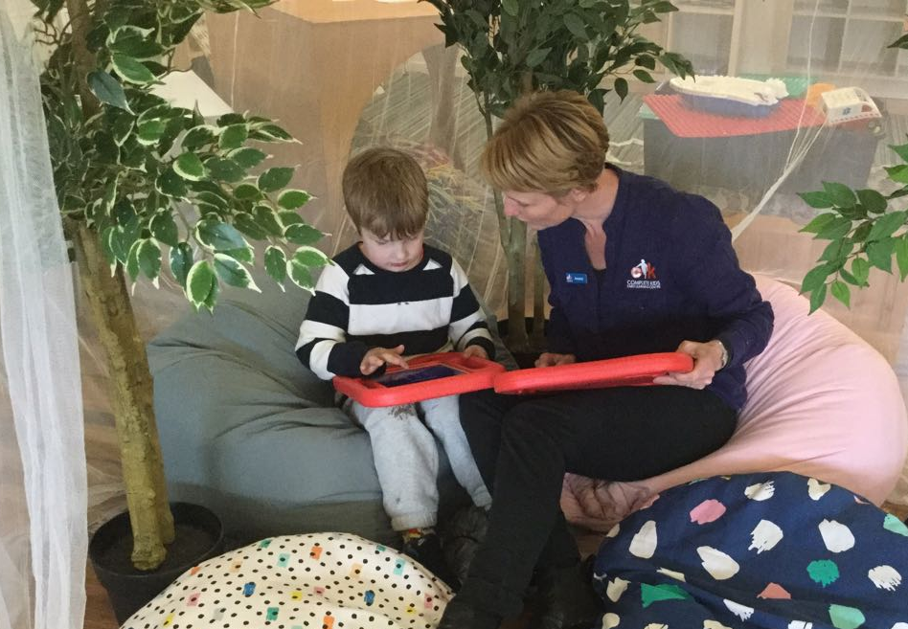
Collaborative partnerships with families and communities
6.2 Collaborative partnerships
Collaborative partnerships enhance children’s inclusion, learning and wellbeing.
6.2.2 Access and participation
Educators make decisions about time spent on the tablet devices in relation to individual needs. They collaborate with medical and other relevant professionals, and with families, to ensure appropriate levels of participation and language learning for all children.

Slide 23
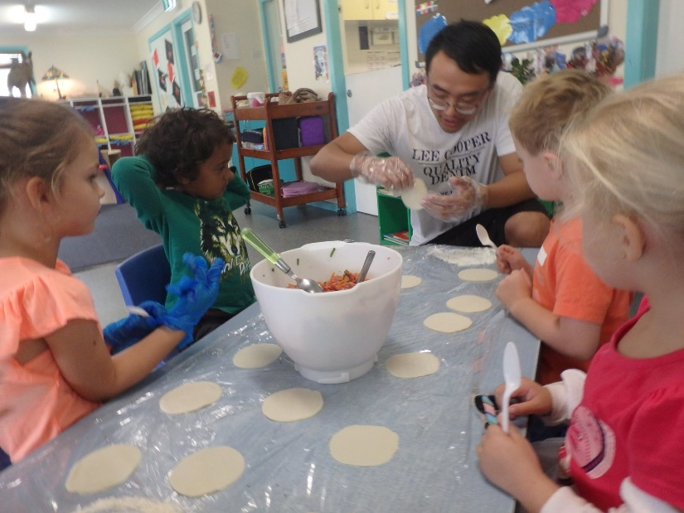
Collaborative partnerships with families and communities
6.2 Collaborative partnerships
Collaborative partnerships enhance children’s inclusion, learning and wellbeing.
6.2.3 Community engagement
The ELLA program encourages the community and preschool services to share language and cultural experiences.
Making dumplings with a community member at Park Beach Child Centre, Coffs Harbour, NSW

Slide 24
Using ELLA to identify some key improvements in your Quality Improvement Plan (QIP)
Identify issues that relate to the current practice at your preschool.
Are there any aspects of the ELLA program that you could put into your QIP?

